Slide 1
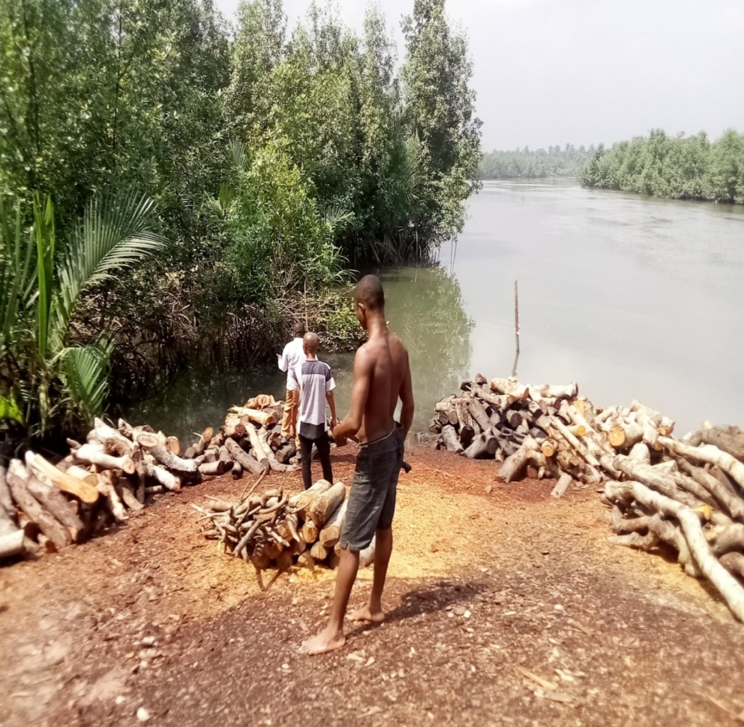
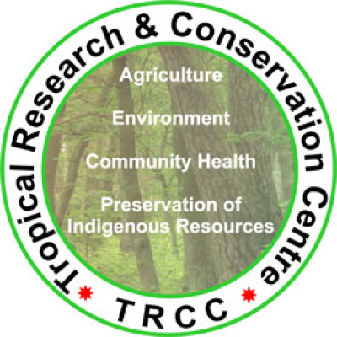

NIGER DELTA MANGROVE RESTORATION PROJECT
(OVERVIEW)
FACILITATED BY
TROPICAL RESEARCH AND
CONSERVATION CENTRE,TRCC,
NIGERIA,NIGERIA
&
FasterCapital,Dubai
Target: 10 MILLION MANGROVE TREES
PROJECT AREA:NIGER DELTA REGION,NIGERIA

Slide 2
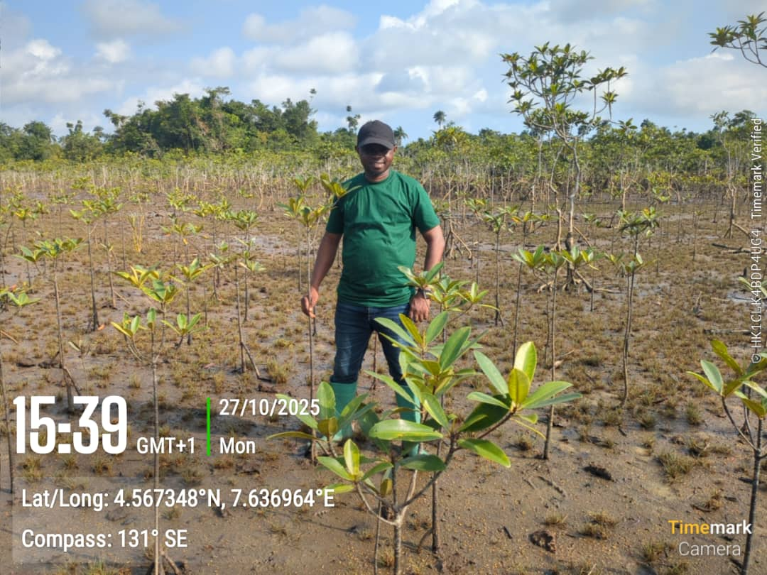
Project country / region:
Nigeria, Niger Delta Region.
Local implementing organization: TROPICAL RESEARCH AND CONSERVATION CENTRE, TRCC,
Address: 41 Oron Road, Uyo, Akwa Ibom State, Nigeria
Email: info@tropicalconservationcentre.org;ikponkenkanta@yahoo.com
Website: www.tropicalconservationcentre.org;
www.tropicalcentre.org
Phone: +234 80 675 96 435
Contact person: Mr. Ikponke Nkanta

Slide 3
Overview:
Niger Delta Mangrove Restoration Project aims to plant 10 million trees, restoring about 2,000 hectares during the project's first three years (project establishment period).
The project also aims mitigate further deforestation by :
-Distributing about 20,000 fuel efficient biomass cookstoves (using sawdust and farm waste),and 1,000 smoke oven for fish drying among the locals depending heaviliy on mangrove woods for fuelwood,thereby reducing dependence on mangroves for fuelwood.
- Providing training (and start inputs) for about 5000 locals in suitable and sustainable agro/eco based enterprises (bee farming,agro forestry, livestock prodution) which can enhance livelihoods without jeopardising the mangroves.
The project will potentially reduce 6.2 million tCO2e in a crediting period of 30 years.

Slide 4
About the local implementer:Tropical Research and Conservation Centre, TRCC, (founded in 2001) is a non-governmental organization (NGO) focusing on environment, natural resources, indigenous resources preservation, sustainable agriculture, and community healthy living.TRCC is dedicated to restoring degraded ecosystems, conserving biodiversity, and improving livelihoods in Nigeria’s Niger Delta through sustainable practices.
TRCC Vision: A society with sound health, and in harmony with the nature.
TRCC Mission: To restore,protect and preserve nature through education,reforestation and conservation practices.
TRCC Achievments:
TRCC has over 20 years of experience leading community-driven conservation initiatives, focusing on mangrove restoration and forest management.
● Over over 500 ha restored to sequester carbon, enchance coastal protection, and mitigate flooding.
●Education and Empowerment: Education and training sessions for local communities (reaching over 50,000 peoeple)on the value of forest and benefits of conservation services, equipping them with skills (organic farming,agro foreestry,susutainable forest use).
Biodiversity Conservation: Restoration and protection of critical habitats for some endangered fauna like Sclater’s guenon monkey,Red capped Red capped mangabey monkey;sea turtles,Africa manatees and threatened bird species.
www.tropicalcentre.org

Slide 5
Background:
Nigeria has extensive mangrove forests in the coastal region of the Niger Delta, considered one of the most ecologically sensitive regions in the world, offering huge environmental,ecological,biological and socio-economic benefits.
The Niger Delta mangrove (about 1 million ha in size, and highly degraded) is the third largest in the world and the largest in Africa. The Niger Delta mangroves perform all four categories of ecosystem services identified in the Millennium Ecosystem Services report: regulating, provisioning,cultural,and supporting services.They serve a critical role in regional ecological and landscape composition, and support subsistence gathering practices, and market-based income opportunities for many Nigerans.Niger Delta mangroves together with the creeks and rivers are a major source of food and livelihood for about miany million people,collecting aquatic/sea food for a living.
The ecosystem not only enhances the socio-economic prosperity of rural coastal communities but also holds promise in shielding them from severe weather occurrences intensified by climate change.They also provide habitats and sustenance to diverse wildlife populations,serving as a reservoir of biodiversity (including birds,monkeys,eptiles,etc). This ecosystem also plays an important role in climate change mitigation because of its high blue carbon sequestration potential.

Slide 6
Despite the important role that Niger Delta mangroves play, anthropogenic pressures(mainly due to subsistence and commercial harvesting of wood) have led to the disappearance of vast stands of mangroves.This has induced biodiversity depletion with a decline in the productivity of aquatic resources, a decrease in community's subsistence means, an increase in poverty.
Consequently, many coastal communities in the Niger Delta are losing their lives and primary livelihoods due to increased vulnerability to floods as a result of the disappearance of mangroves which usually serve as defense in times of coastal flooding. They are also now exposed to the high intensity of sunlight and heat waves as the land lay bare of trees to regulate sun rays. Therefore, there is urgent need to restore and conserve the mangroves of the Niger Delta region.

Slide 7
Main environmental impacts of the project:
• Increased in abundance of aquatic life as mangroves constitute important nurseries for fishes, crustaceans, sponges, algae and other invertebrates. Mangroves are also used as shelter by primates,birds, and breeding grounds by small mammals, reptiles, and insects.
•Reduced coastal erosion/flood as mangrove vegetation helps in protecting coastlines against wave damage during storms.
Main socio –economic/livelihood impacts of the project:
-Job creation (among youth planting/monitoring) and women ( collecting the seeds)
-Increased catch, food security and economic resilience (fishermen and women collecting aquatic food for domestic and commercial purposes) etc.

Slide 8
Objectives:
-To restore degraded mangrove forest portions,engaging the locals in planting back mangroves at degraded portion , targeting 10 million trees.
-To increase local awareness in mangrove conservation needs, and sustainable mangrove ecosystem utilization.
-To migitiate deforestation relating to cutting down of mangroves for fuel wood,by providing local support in the use fuel efficient biomass cookstoves (using sawdust and farm waste),and smoke oven for fish drying (targeting 20,000 cookstoves, and 1000 smoke ovens).
To build local capacity (and provide startup support) in ecofriendly enterprises as livelihood alternatives among local commerical mangrove wood harvesters :bee farming, agro forestry, snail farming, mushroom farming, rabbit farming, grass cutter farming, piggery ,poultry,goat keeping targeting 5000 pro poor locals.

Slide 9
Planting sites/communities:
States/Communities:
Rivers state:
Opobo:https://en.wikipedia.org/wiki/Opobo ;
https://www.youtube.com/watch?v=ExMHGxmoLzA;
Ogaji ama-Buguma:https://en.wikipedia.org/wiki/Buguma
Owuwukiri-Bonny :https://mapcarta.com/26451956;
https://places-in-the-world.com/nigeria/bonny-owuwukiri/7053139
Abalama: https://www.mindat.org/feature-2341491.html
https://en.wikipedia.org/wiki/Abalama
Akwa Ibom state:
Ukpum Ette-Ikot Abasi:https://en.wikipedia.org/wiki/Ikot-Abasi
Eastern Obolo:https://en.wikipedia.org/wiki/Eastern_Obolo
Mkpanak-Ibeno:https://www.mindat.org/feature-7054635.html
https://en.wikipedia.org/wiki/Ibeno
Esuk Oro-https://en.wikipedia.org/wiki/Esuk_Oro
Mbo:https://en.wikipedia.org/wiki/Mbo,_Nigeria

Slide 10
( C) Ondo state:
Obinehin-
:https://www.google.com/maps/place/Obinehin+Market,/@6.3151879,4.5519977,694m/data=!3m2!1e3!4b1!4m6!3m5!1s0x103f2defd8e5d69f:0x810108abb38b7598!8m2!3d6.
Awoye-Ilaje:https://www.mindat.org/feature-2348736.html
https://en.wikipedia.org/wiki/Ilaje
Obenla-Ilaje:https://www.mindat.org/feature-2328299.html
https://mapcarta.com/17002276
( D) Delta state:
Omadino- Warri south:https://en.wikipedia.org/wiki/Omadino_Community;
https://warrikingdom.org/omadino-community-in-brief/
Tsekeluwu-Warri North:https://www.tageo.com/index-e-ni-v-00-d-m2818190.htm

Slide 11
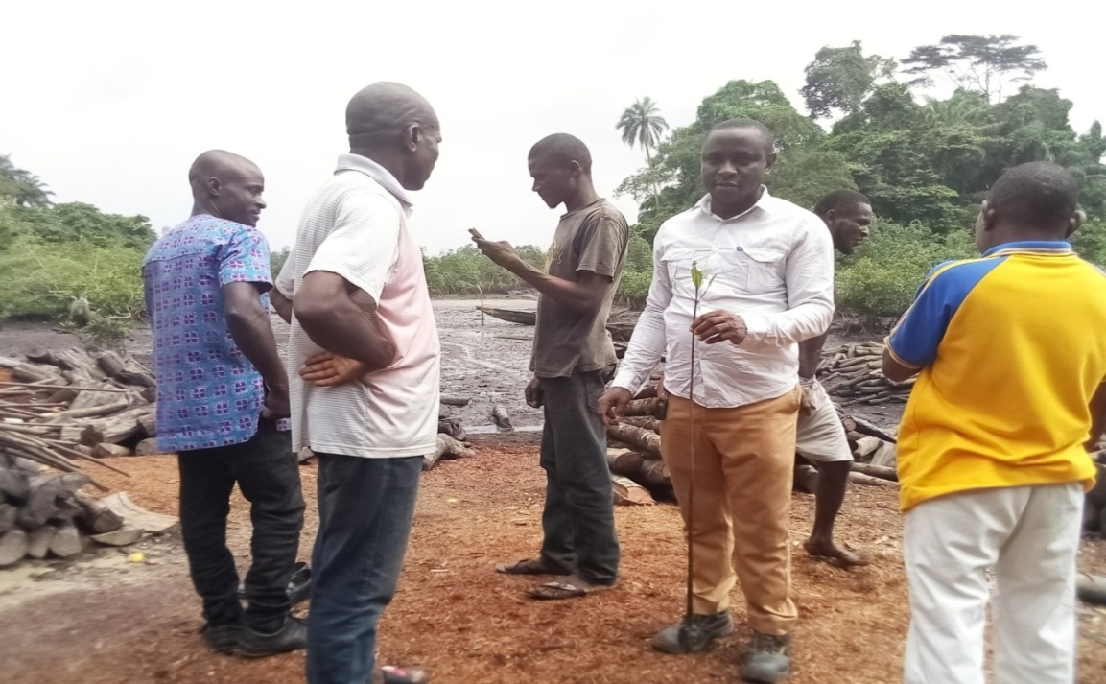
Approaches/Aactivities:
Awareness creation:
Participatory planting and maintaining of the mangroves (engaging the locals,local forestry departments)
-Identification of mangrove communities.planting sites:
Along with the locals, planting spots were identified and marked out for planting

Slide 12
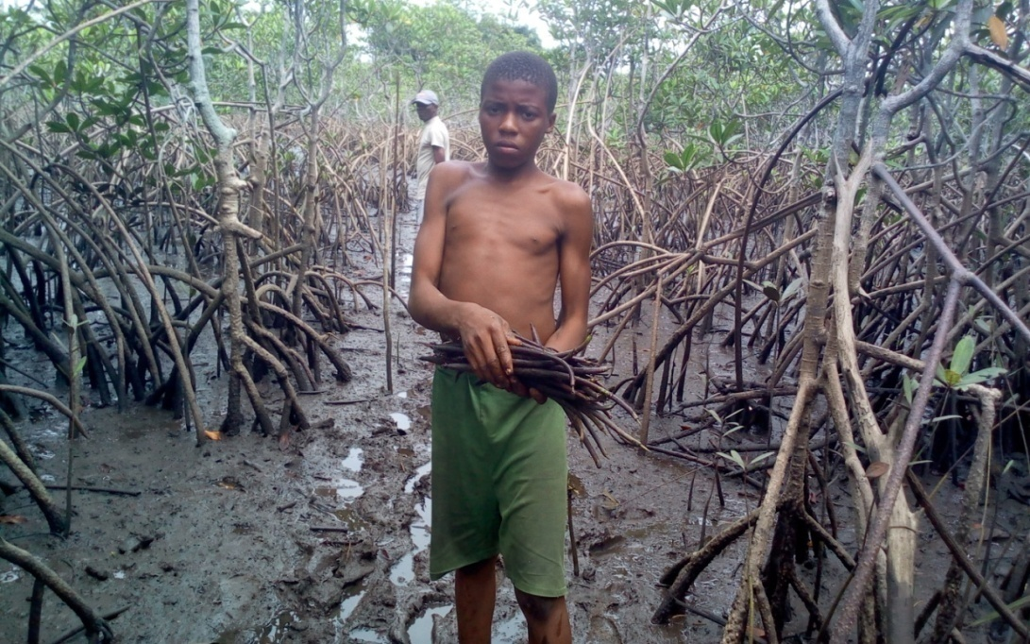
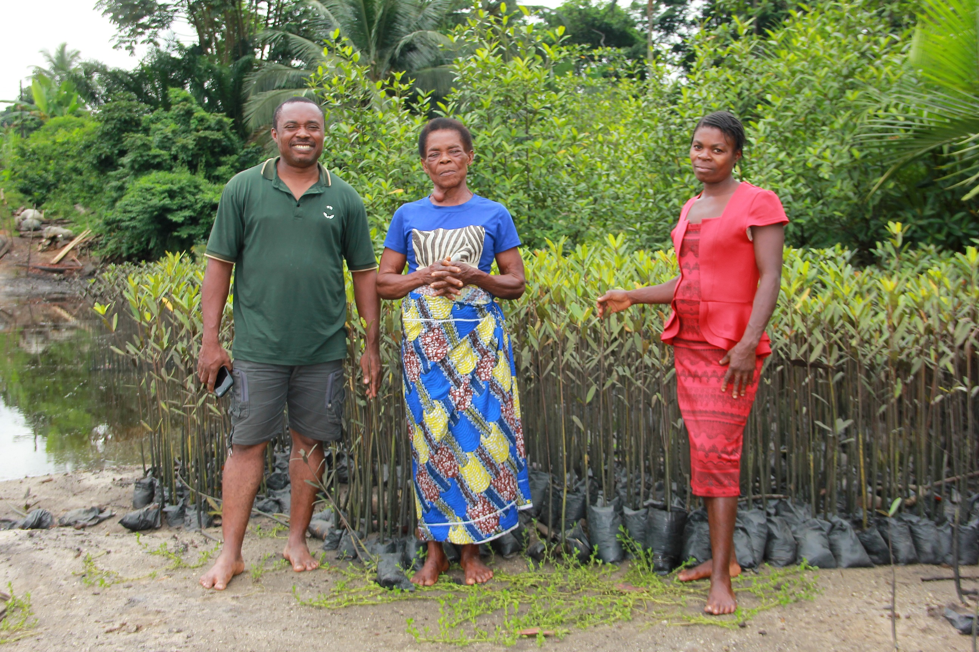
Seeds collection and nursery establishment:

Slide 13
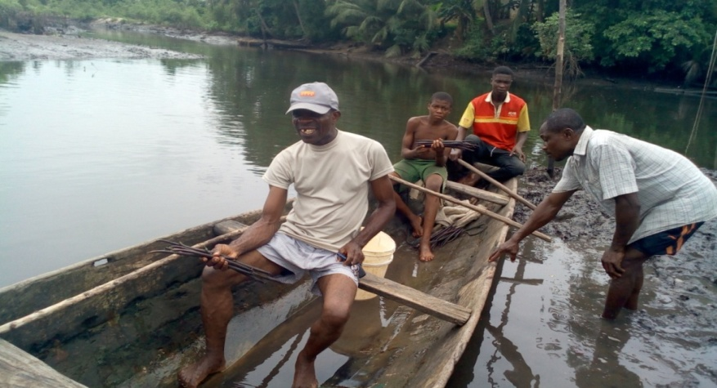
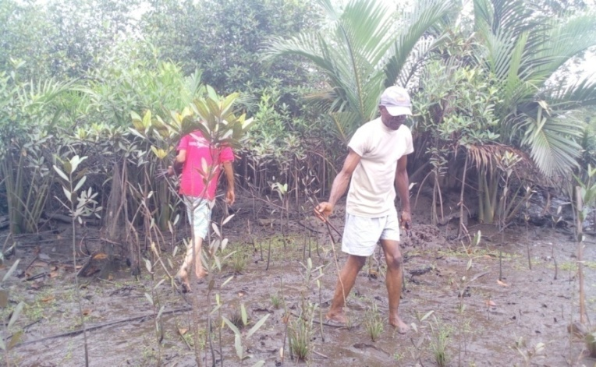
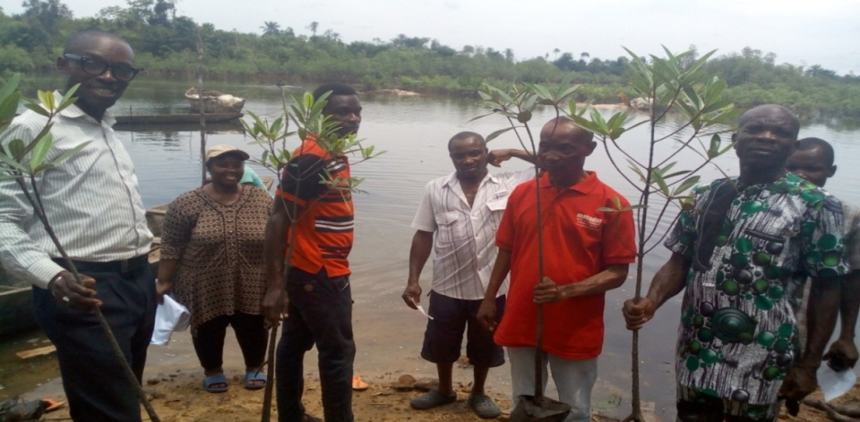
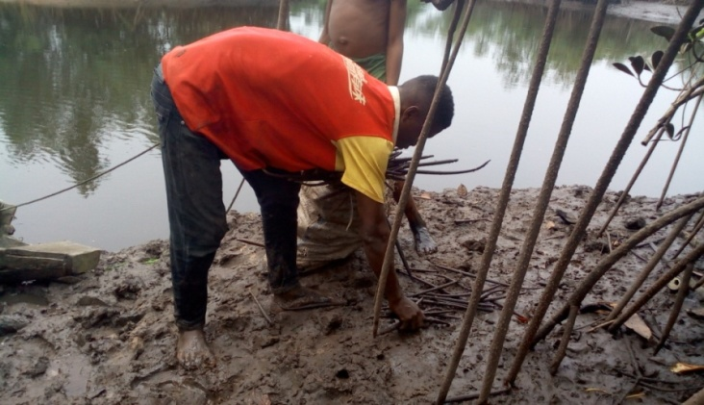
Planting of mangroves:Eitehr by direct seed planting or seeddlings from nurseries

Slide 14
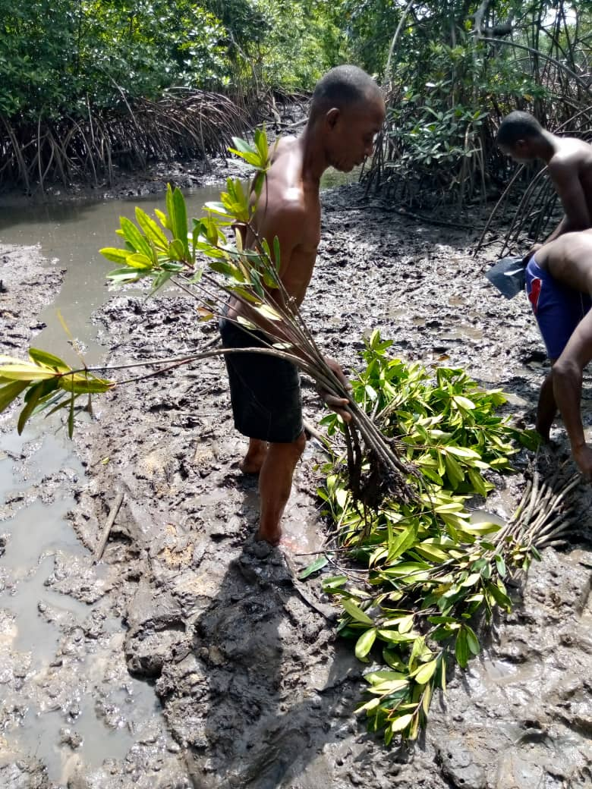
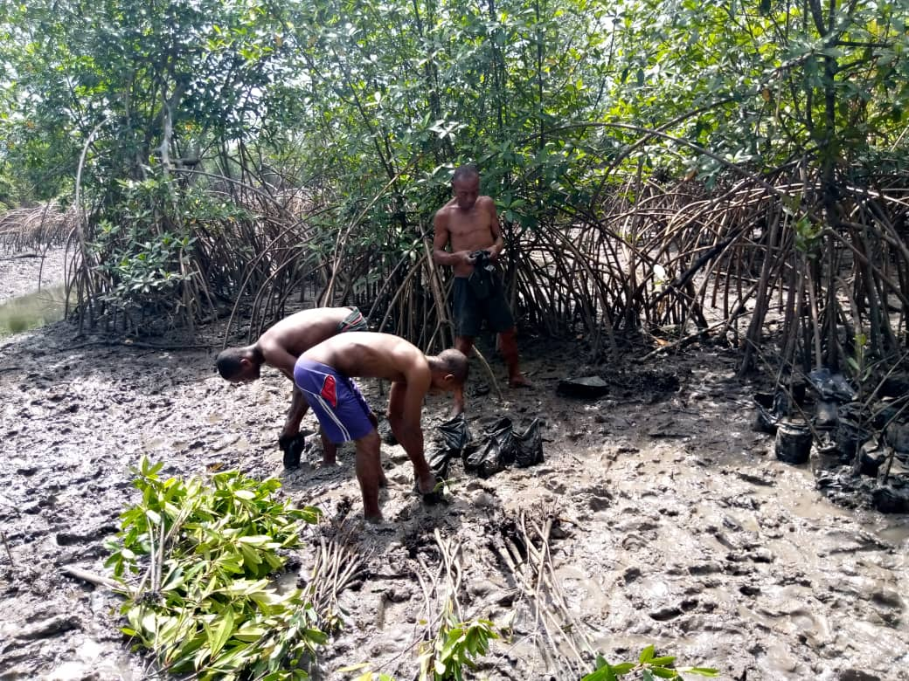

Slide 15
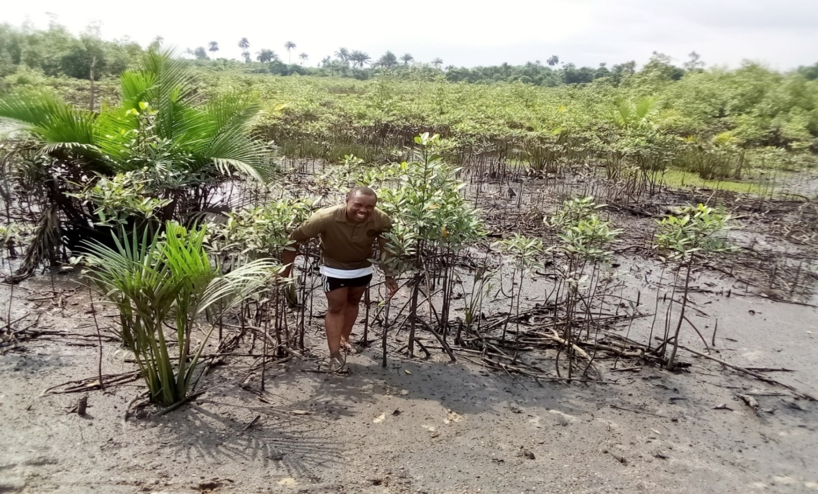
Project/ Tree Monitoring:
Monitoring involves re-meetings, interviews with the locals and field checks of the trees to determine their condition, survival rate and replacement of death stands (if any),mapping of planted areas.

Slide 16
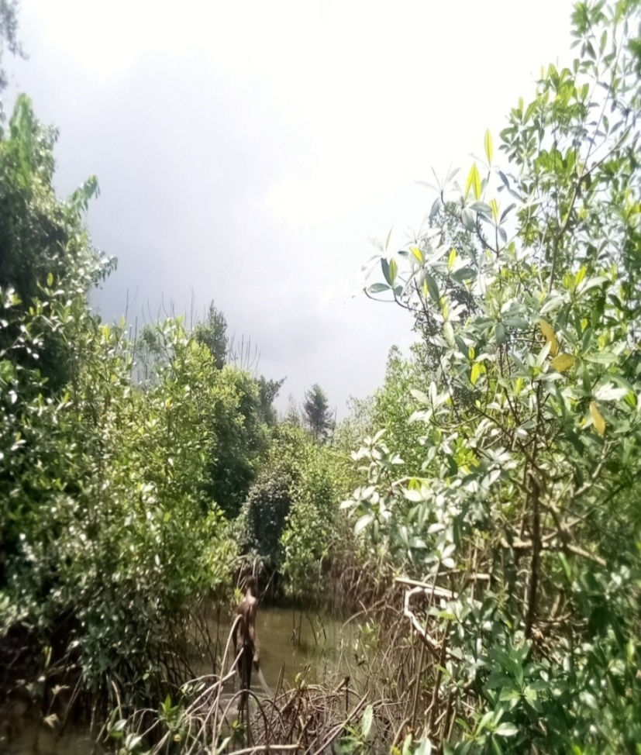
Project relevance:
Mangrove forests play an important role in carbon removals because they are among the most carbon-dense ecosystems in the world, and if kept undisturbed, mangrove forest soils act as long-term carbon sinks. The importance of protecting mangroves is reflected most clearly in Sustainable Development Goal (SDG) 14, which focuses on sustainably governing our oceans and coasts and recognizes mangroves’ immense value to local communities. Sustaining mangrove forests also supports the achievement of many other SDGs, including eliminating poverty and hunger (SDG 1 and SDG 2), ensuring livelihoods and economic growth (SDG 8), taking actions against climate change impacts (SDG 13) and halting biodiversity loss (SDG 15).

Slide 17
The project is in line with the “National Poverty Reduction Strategy” which supports improving local resource management as a key element of poverty reduction. It is also in line with the Convention on Biodiversity (CBD) ratified in Nigeria in 1994; the African Convention on the Conservation of Nature and Natural Resources; the Convention on Nature Protection and Wildlife Protection in the Western Hemisphere; Agenda 21; the RAMSAR Convention on Wetlands of International Importance. It is also consistent with aims and objectives of the National Biodiversity Strategy and Action Plan (NBSAP); UNIDO and Niger Delta Biodiversity Bio-diversity Programmed recommendations for mangrove conservation within the region.
Here a video link on mangroves with which can help one learn more about mangroves: https://www.youtube.com/watch?v=cwTZhyA57mA

Slide 18
Expected project Impacts:
-Degraded mangrove sites restored and sustainable managed by the locals; ensuring protective habitat for many coastal species.
- Increased in number of juvenile crabs, fish, shrimps, snails, periwinkles, turtles etc as their habitat (mangrove) is improved for their survival, thus protecting and sustaining an important food source for coastal communities.
- Reduced coastal erosion/flood; Mangrove vegetation helps in protecting coastlines against wave damage during storms.
-Immediat direct employment for over 200+ locals within the first 3years of the project:
women collecting the seeds (propogules) and youth planting the mangroves.
-Indirect employment opportunities from 3yeras + (for about 6000 returning fishermen and 4000 women for the collection of aquatic produce – fish, crabs, shrimps, oysters etc – to increase food security and economic resilience.

Slide 19
